Slide 1


Rainfall Forecasting for Pune Region
Aman Pawar 250243025003
Shriganesha Jibhakate 250243025040
Soni Singh 250243025042
Pranit Wankhade 250243025053
Guided By:
Mr. Milind Kapse

Slide 2
PROBLEM STATEMENT
ABSTRACT
DATASET
SYSTEM ARCHITECTURE
MACHINE LEARNING
LIGHT GBM
RANDOM FOREST
DECISION TREE XGBOOST
RESULTS
OUTPUTS
CONCLUSION
FUTURE SCOPE
01
02
03
04
TABLE OF CONTENTS
05
06
07
08
00

Slide 3

Problem Statement
The task is to forecast the rainfall in Pune, India, using historical weather data. This is a regression problem focused on predicting a continuous variable. The dataset comprises past rainfall measurements and other pertinent features such as humidity and wind speed to assist in forecasting rainfall conditions.

Slide 4
Abstract :
This project presents an intelligent system for precise 24-hour rainfall forecasting advanced machine learning.
Leveraging Apache Spark for efficient ETL, the architecture stores processed data in HDFS for scalability and fault tolerance.
To enhance short-term forecasting, the system utilizes Linear Regression , Random Forest, XGBoost and Decision Tree algorithms, augmented by time-aware modeling.
Tableau integration provides interactive dashboards for intuitive visualization of historical trends, model outputs, and rainfall patterns.
This synergistic combination of predictive modeling and real-time visual analytics empowers stakeholders to respond effectively to evolving meteorological conditions, enhancing preparedness in agriculture, disaster management, and urban planning.

Slide 5
Dataset:
The Pune Region Dataset contains 123937 entries and 20 columns. Here are the key details:
Column Overview:
date_time: Timestamp for each record.
temperature_2m: Air temperature at 2m above the surface.
relative_humidity_2m: Humidity level at 2m.
dew_point_2m: temperature at which air becomes saturated with moisture.
apparent_temperature: How hot or cold it feels.
pressure_msl: Atmospheric pressure at mean sea level.
surface_pressure: Atmospheric pressure at the ground level.
cloud_cover, cloud_cover_low,cloud_cover_mid, precipitation, windspeedKmph: Various meteorological variables.

Slide 6
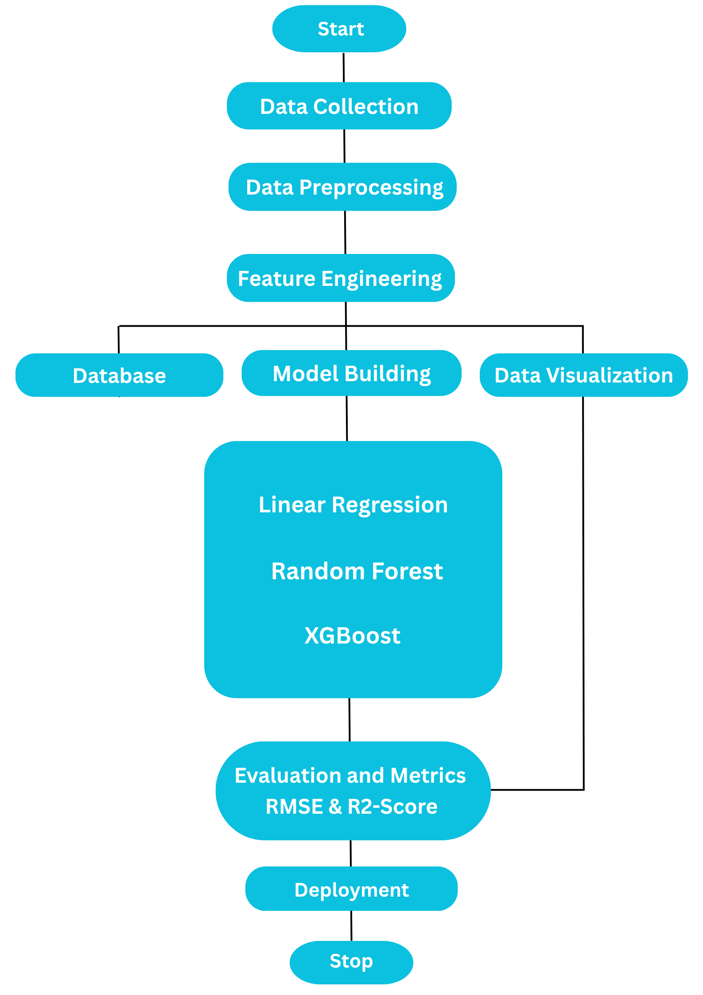
System Architecture:

Slide 7
Architecture Details:
ETL Processes:
Used Apache Spark for efficient ETL.
Data Storage:
Stored in HDFS for scalable and fault-tolerant storage.
Machine Learning Models:
Applied Random Forest, XGBoost, and Decision Tree for Rainfall Forecasting.
Performance:
High accuracy and reliability demonstrated.

Slide 8
Linear Regression:
Algorithms
A Linear Regression model predicts a continuous target variable by finding the linear relationship between the input features and the target.
Ridge:
A linear regression method that uses L2 regularization, which helps prevent overfitting by adding a penalty to the size of the coefficients.
Lasso:
A linear regression method that uses L1 regularization, which can shrink some coefficients to zero, effectively performing feature selection.

Slide 9
Linear Regression:
Algorithms
MSE: 0.044059 RMSE: 0.209903 R-Squared: 0.341214
Ridge:
MSE: 0.044057 RMSE: 0.209897 R-Squared: 0.341251
Lasso:
MSE: 0.066880 RMSE: 0.258611 R-Squared: -0.000007

Slide 10
Decision Tree:
Algorithms
A Decision Tree Regression model predicts continuous values by creating a tree-like structure that splits the data based on feature values to make predictions.
Mean Squared Error (MSE): 0.04588783
R-squared: 0.31387199
Light GBM:
A Decision Tree Regression model predicts continuous values by creating a tree-like structure that splits the data based on feature values to make predictions.
Mean Squared Error (MSE): 0.04588783
R-squared: 0.31387199

Slide 11
Random Forest:
Algorithms
A Random Forest Regressor, an example of ensemble learning, combines multiple decision trees to improve prediction accuracy and robustness by averaging their outputs to make final predictions.
Model Parameters:
'n_estimators': [100, 200, 300, 400],
'max_features': ['sqrt', 'log2', 0.6, 0.8, 1.0],
max_features 'max_depth': [10, 20, 30, None], 'min_samples_split': [2, 5, 10], 'min_samples_leaf': [1, 2, 4], 'bootstrap': [True, False],
Best Model Hyperparameters:
'n_estimators': 400, 'min_samples_split': 2, 'min_samples_leaf': 2, 'max_features': 'sqrt', 'max_depth': 30, 'bootstrap': False}

Slide 12
XGBoost :
Algorithms
XGBoost is a powerful ensemble learning method that combines the predictions of multiple decision trees to improve accuracy and handle complex patterns in data.
Model Parameters:
Maxdepth : Maximum depth of a tree(values tested: [3, 4, 5, 6, 7, 8, 9, 10]).
Learning rate : Step size shrinkage used to prevent overfitting. [0.01, 0.05, 0.1, 0.15, 0.2],.
Gamma : Minimum loss reduction required to make a further partition on a leafnode. ([0, 0.1, 0.2, 0.3, 0.4],])
Best Model Hyperparameters XGBoost: 'n_estimators': 300, 'max_depth': 9, 'learning_rate': 0.05, 'gamma': 0.3

Slide 13
LightGBM
Algorithms
LightGBM is a gradient boosting framework that uses tree-based learning algorithms. It is designed to be distributed and efficient, making it suitable for large datasets, and is known for its speed and high performance.
Model Parameters:
Maxdepth : Maximum depth of a tree (values tested: [-1, 10, 20, 30])
learning_rate: Step size shrinkage used to prevent overfitting (values tested: [0.01, 0.05, 0.1, 0.15, 0.2]).
subsample: Fraction of samples used for fitting the individual base learners (values tested: [0.6, 0.7, 0.8, 0.9, 1.0]).
Best Model Hyperparameters: subsample': 0.8, 'num_leaves': 31, 'n_estimators': 500, 'min_child_samples': 20, 'max_depth': 20, 'learning_rate': 0.15

Slide 14
Results:
Model | Before Hyperparameters |  |  | After Hyperparameters
 | MAE | RMSE | R-Sqr | MAE | RMSE | R-Sqr
Random Forest | 0.021044 | 0.145066 | 0.685342 | 0.020054 | 0.141613 | 0.700143
LightGBM | 0.022548 | 0.150159 | 0.662858 | 0.019477 | 0.139559 | 0.708777
XGBoost | 0.022633 | 0.150444 | 0.661578 | 0.021537 | 0.146755 | 0.677974

Slide 15
Results:
Model | Before Hyperparameters
 | MSE | RMSE | R^2
Linear Regression | 0.044059 | 0.20990. | 0.341214
Lasso | 0.066880 | 0.258611 | -0.000007
Ridge | 0.044057 | 0.209897 | 0.341251

Slide 16
Conclusion:
Successful Model Development: Developed a machine learning model that forecasts rainfall with reasonable accuracy based on historical data.
Data Processing and Analysis: Demonstrated effective data preprocessing, feature selection, and model training techniques.
Valuable Insights: Provides valuable insights into future rainfall trends in Pune.
Impact on Stakeholders: Aims to assist stakeholders in rainfall-sensitive sectors such as agriculture, tourism, and infrastructure development with improved decision-making.
Addressing Climate Challenges: Contributes to efforts in mitigating the impacts of rain
variability and advancing understanding of regional climate dynamics.

Slide 17
Future Scope:
High-Resolution Data Integration: Integrate high-resolution data from various sources for improved rainfall forecasting.
ETL Processing with Apache Airflow: Use Apache Airflow to streamline ETL processes and improve data pipeline management.
Advanced Feature Engineering and Deep Learning: Explore further feature engineering and implement deep learning architectures for enhanced forecasting accuracy.
Uncertainty Estimation and Localized Predictions: Develop methods for estimating uncertainty and making localized predictions.
Decision Support Integration: Integrate the model with decision support systems for urban planning and disaster management.

Slide 18
THANK
YOU !!

